Slide 2
CNI-agnostic network performance accelerator with eBPF
Yizhou Xu, Intel
Mengxin Liu, Alauda

Slide 3
Agenda
TCP/IP stack overhead
eBPF background knowledge
How to bypass Tcp/Ip with eBPF
Performance Analysis
Practice on KubeVirt acceleration

Slide 4
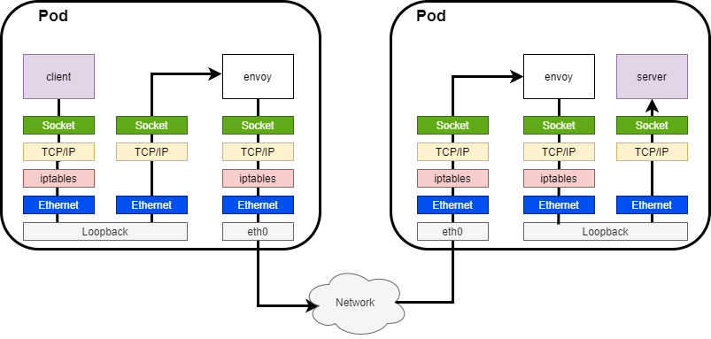
TCP/IP stack overhead
In Kubernetes, each pod has its own network stack, packet from one pod to another traverse whole stack multiple times
In particular, service mesh amplify the overhead by sidecar mode
Tcp/ip overhead in Pod to Pod (same host)
Tcp/ip overhead in Service Mesh (same host)
Notes:
TCP/IP (Transmission Control Protocol/Internet Protocol) is the foundational protocol suite of the Internet and plays a crucial role in modern networking.
All the application data goes via sidecar (Envoy*)
All the data passes TCP/IP stack 3 times
Inbound
Outbound
Envoy to Envoy (same host)

Slide 5
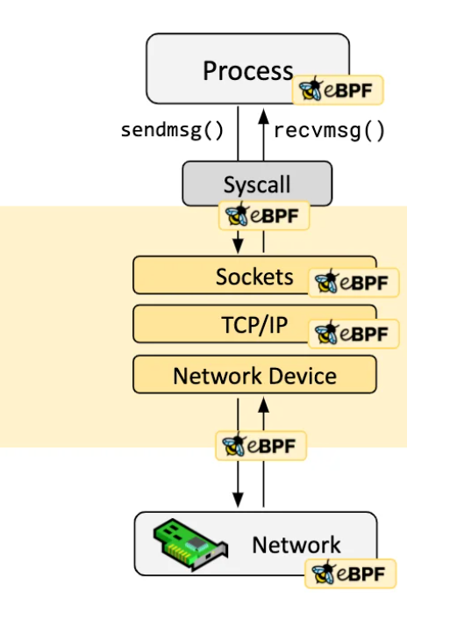
Why use eBPF
Work in Kernel
Non-intrusive
CNI agnostic
Safety and efficient

Slide 6
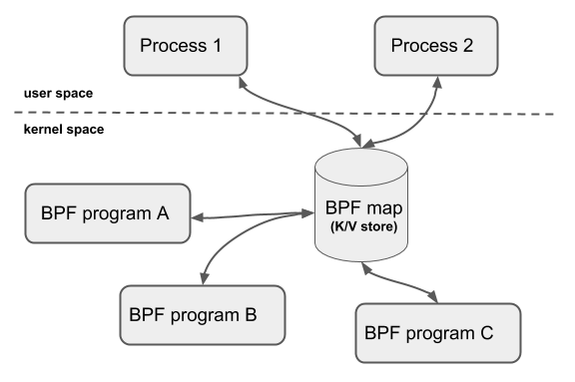
eBPF background knowledge – Map&Prog
MAP
provide generic data structure for user space
and kernel space communication
HASHMAP
SOCKHASH
Program type
SOCK_OPS
SK_MSG
Notes:
sock_ops
Set callbacks for TCP state changing
Help functions: BPF_MAP_UPDATE_ELEM, BPF_SOCK_HASH_UPDATE
SK_MSG
Attach to a SOCKHASH map, capture the packets sent by a socket in SOCKHASH map and determine its destination socket
Help functions: BPF_MSG_REDIRECT_HASH

Slide 7
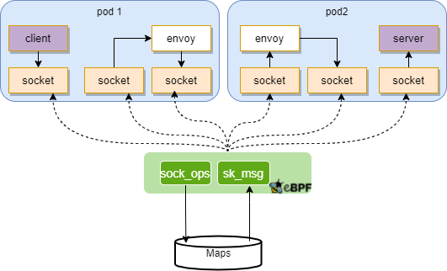
Combining MAP & Program for acceleration
sock_ops
capture socket in given status, populate into map
sk_msg
when there is data in socket, lookup peer socket
transfer data to peer

Slide 8
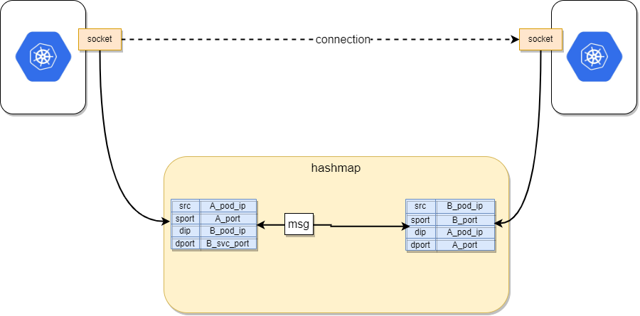
Pod to Pod acceleration(Kubernetes)

Slide 9
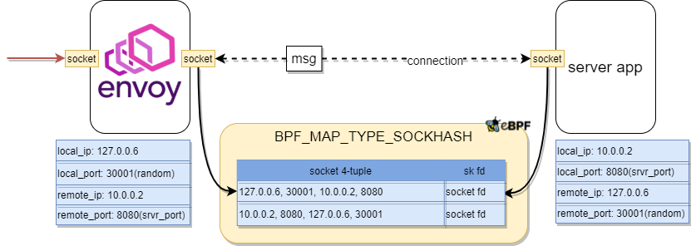
Inbound Acceleraion(Service Mesh)

Slide 10
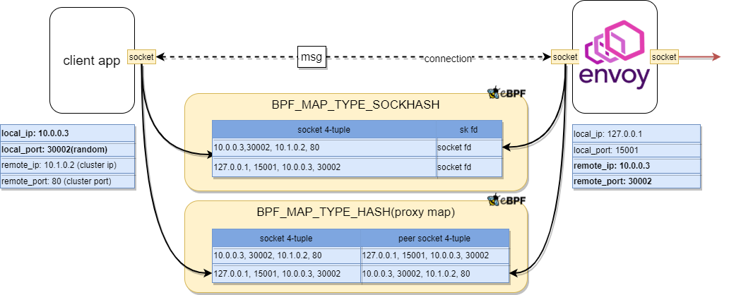
Outbound Acceleration(Service Mesh)

Slide 11
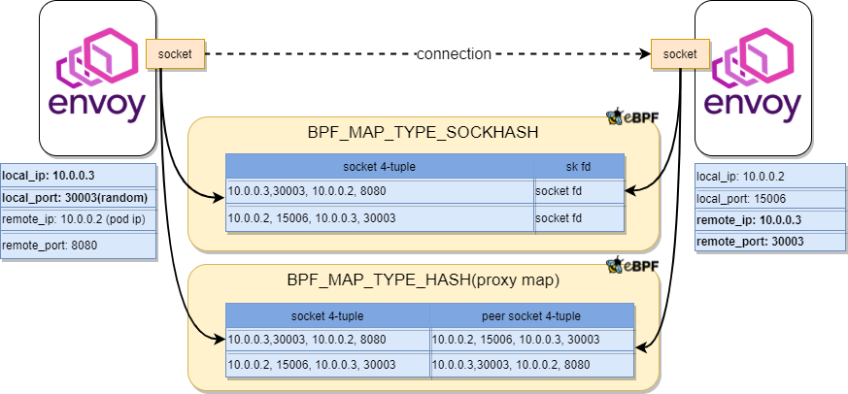
Envoy to Envoy Acceleration (same host)

Slide 12
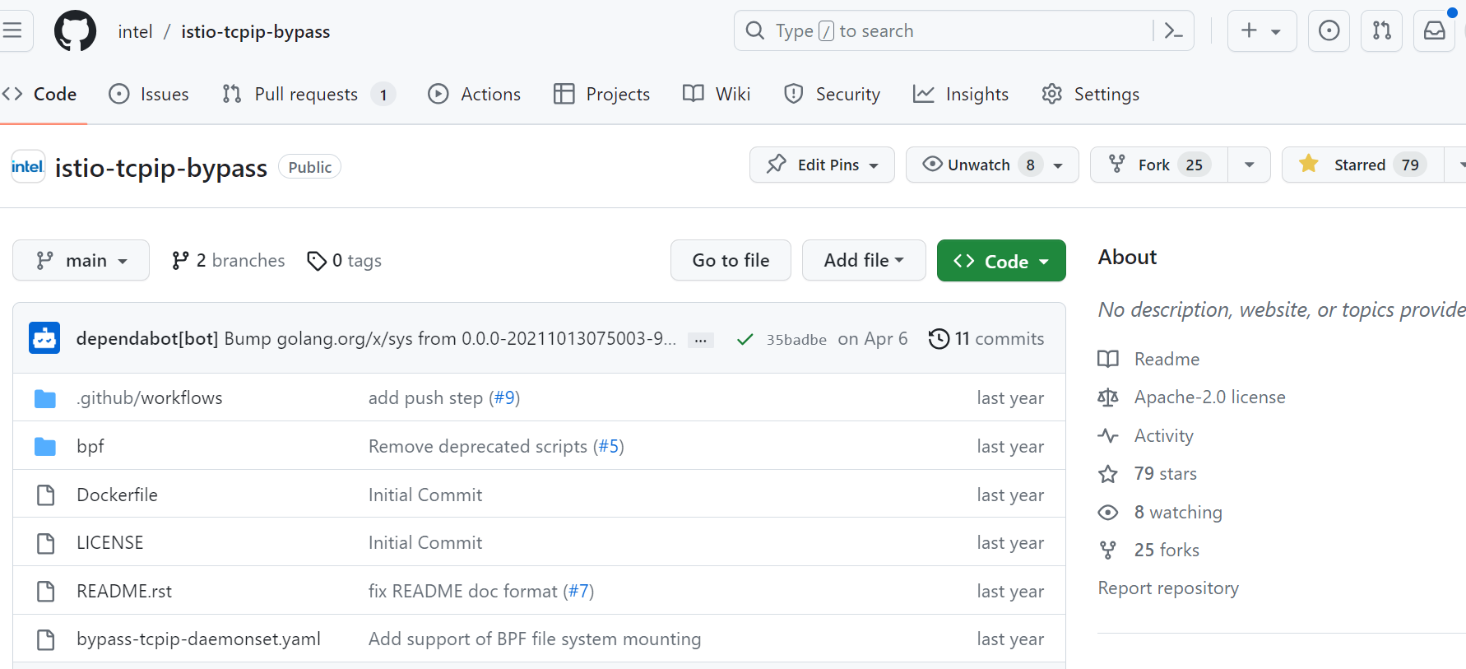
It’s opensource!
REPO: https://github.com/intel/istio-tcpip-bypass

Slide 13
Benchmark
Deploy two test Pods in the same Node
Use qperf to benchmark TCP latency/bandwidth with packet sizes from 1byte to 16KB
qperf -t 60 100.64.0.3 -ub -oo msg_size:1:16K:*4 -vu tcp_lat tcp_bw
Compare with the benchmark when the optimization is disabled

Slide 14
Benchmark Analysis
TCP latency will decrease by 40% ~ 60%
Throughput will increase by 40% ~ 80% when the packet size is greater than 1024 bytes
When the packet size is less than 512 bytes, the throughput decrease due to per packet processing overhead

Slide 15
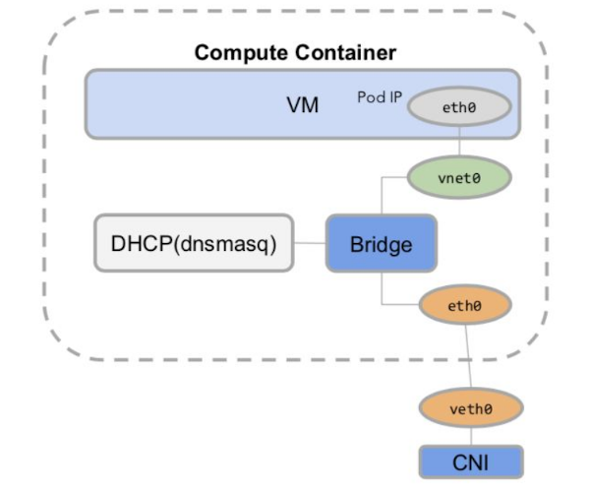
KubeVirt network performance
Native Kubevirt Bridge networks have a much larger performance gap compared to Pods.
Latency increased by 60%
PPS decreased by 50%.
Possible causes:
The consumption brought by the virtualized Linux network stack itself
Additional losses caused by the multiple layers of KubeVirt Bridge network.
Kata has already utilized tc-mirror to bypass the bridge

Slide 16
KubeVirt network acceleration
Both tc-mirror and bpf_redirect are tried
tc-mirror performed slightly better than bpf_redirect in all tests
tc-mirror do not require high version kernel
We didn’t find way to redirect from VM eth0 to veth0 directly
Latency decrease 5% but throughput decrease about 20%
Disable checksum
No need checksum for internal packet processing
Both rx/tx are disabled
TC-Mirror

Slide 17
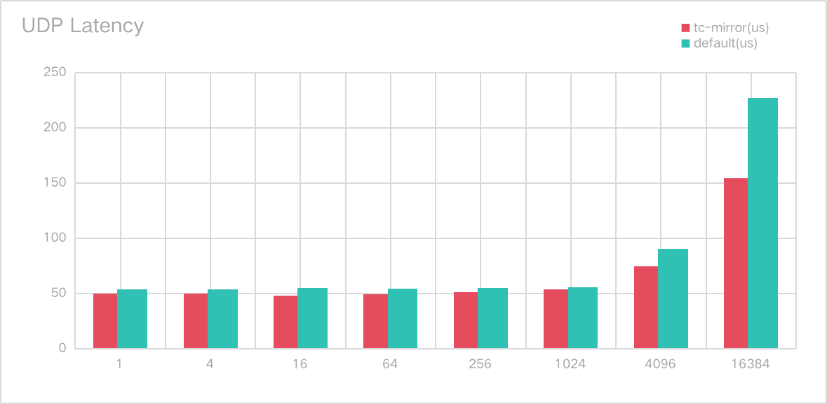
Benchmark
Use qperf to benchmark UDP latency/bandwidth with packet sizes from 1byte to 16KB
Latency 4%~30% decrease
Throughput 20%~70% improvement

Slide 18
Future work
Accelerate UDP inter-node traffic
Fine-grained control the switch between eBPF datapath and kernel network datapath
Accelerate Kubevirt VMs traffic within the same Node

Slide 19
Notice and Disclaimer
Intel technologies may require enabled hardware, software or service activation.
No product or component can be absolutely secure.
Your costs and results may vary.
© Intel Corporation. Intel, the Intel logo, and other Intel marks are trademarks of Intel Corporation or its subsidiaries. Other names and brands may be claimed as the property of others.

